Slide 1


Social Buzz
Analytical Report

Slide 2


Today's agenda
Project recap
Problem
The Analytics team
Process
Insights
Summary

Slide 3


Social Buzz, an immensely growing social media platform
that provides users to post content and react to them
anonymously.
Due to this immense growth, they want to adapt their
systems globally.
Accenture has begun a 3 month POC focusing on
the following tasks:
An audit of Social Buzz’s practice for Big Data.
Recommendations for a successful IPO.
Analysis to find top 5 most popular content categories
in Social Buzz.
Project Recap

Slide 4


Problem
500 million active users every month.
100k pieces of content uploaded everyday
That’s 36.5 million pieces of content every year.
So, what to do to get most out of this data and manage it?
Analyzing the data of Social Buzz to find the top 5 most popular categories of content.

Slide 5




Andrew Fleming
Chief Technology Architect
The Analytics Team
Marcus Rompton
Senior Principal
Michelle Grove
Data Scientist
Vivek Manglani
Data Analyst

Slide 6

Process
1
Data Understanding
2
Data Cleaning
3
Data Modelling
4
Data Analysis
5
Understanding Insights

Slide 7


Insights
The top 5 popular content categories on Social Buzz are Animals, Science, Healthy Eating, Technology, and Food.
Animals is the most popular category with the highest score, suggesting users are interested in this category.
Most uploads in category Animals are of type Photos.
Whereas category Science which is second most popular category has most uploads in Video Format.
6 A.M. – 9 A.M. are peak upload hours.
May 2021 had the most amount of uploads with Sunday and Monday being the most active days.

Slide 8
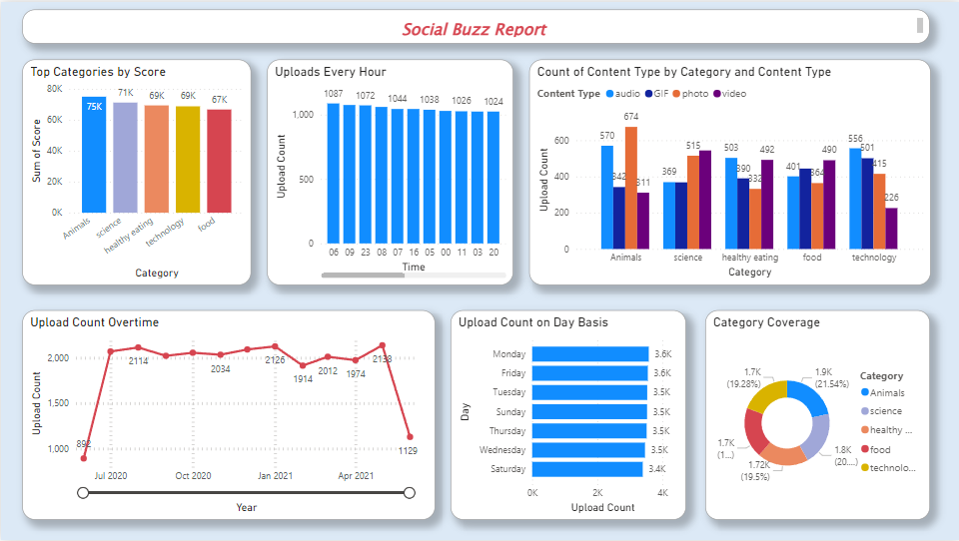

Slide 9


By using insights into the timing and format of user activity on the platform, Social Buzz is able to optimize the timing of content publication to reach the greatest number of users and maximize engagement with the content. A comprehensive analysis of the most popular content formats for each category can also be used to tailor content to specific formats that are more likely to resonate with users, thereby increasing engagement and overall platform growth.
Summary

Slide 10
Thank you!
ANY QUESTIONS?

